Slide 1
Meeting -07
Magician Project Update

Slide 2



Project: Magician
Status Update
Meeting -07

Slide 3
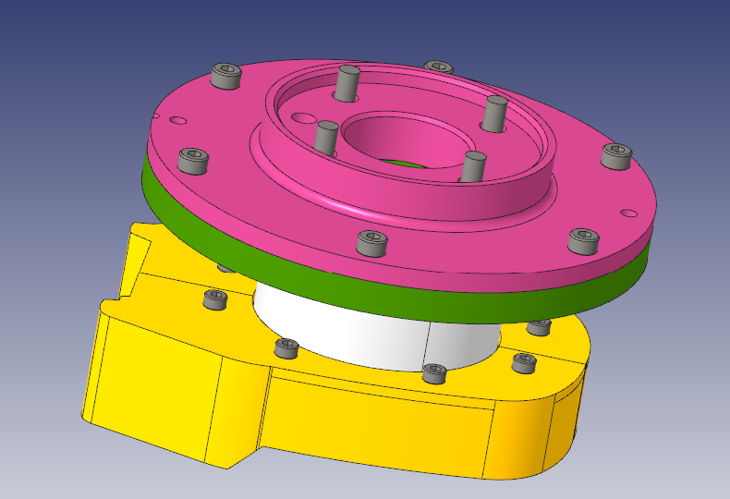
Work Status Update for the Project Magician
Completed Direct Flange Assembly for Doosan.
Modified the design of the direct flange for the Doosan Robot with the FT sensor Mini- 58.
Also did the GT&T drawing for the respective parts and now in the process of machining.

Slide 4
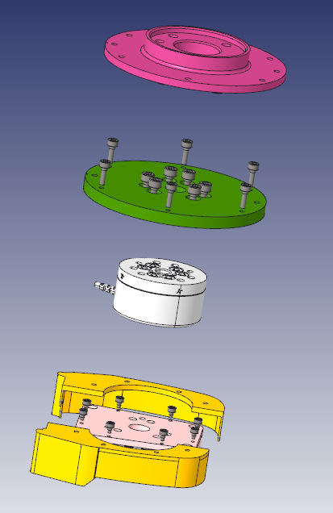
Flange for Dossan_H2515 (mg0001a0)
Flange that will attach ft sensor
(mg0004a0)
FT sensor Mini - 58
3d printed side split cap that will be attached to the metal top cap
Metal top cap for Dewalt tool
(mg0005a1)
Exploded view of the assembly of the direct attachment of the tool to the robotic arm

Slide 5
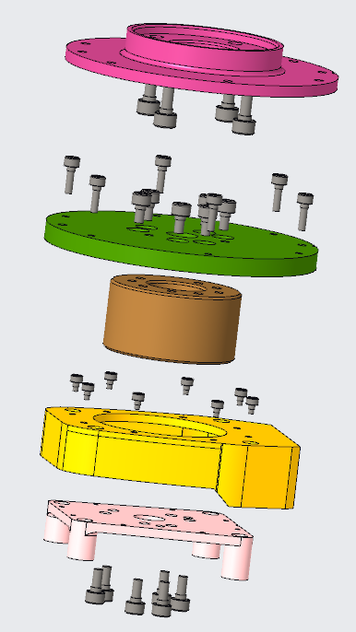
Exploded view of the assembly of the direct attachment of the tool to the robotic arm
Flange for Dossan_H2515 (mg0001a0)
Flange that will attach ft sensor
(mg0004a0)
Dummy FT sensor Module
3d printed side split cap that will be attached to the metal top cap
Metal top cap for Dewalt tool
(mg0005a1)

Slide 6
Work Status Update for the Project Magician
3 proposed designs for vibration isolation:

Slide 7
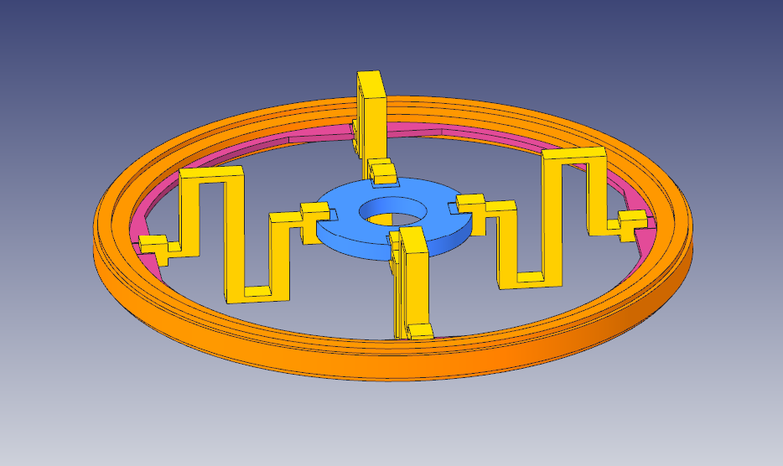
Work Status Update for the Project Magician
Type - I
This type of folded beam design is very effective in mitigating the vibrations that are generated in the planer axes ( in x, y) but not that effective in z- axis vibration ( i.e. in the axial direction).
It is the most simplest and easy to incorporate in any design.
Also the beam stresses could be calculated using the Euler-Bernoulli beam bending equation.
y
x

Slide 8
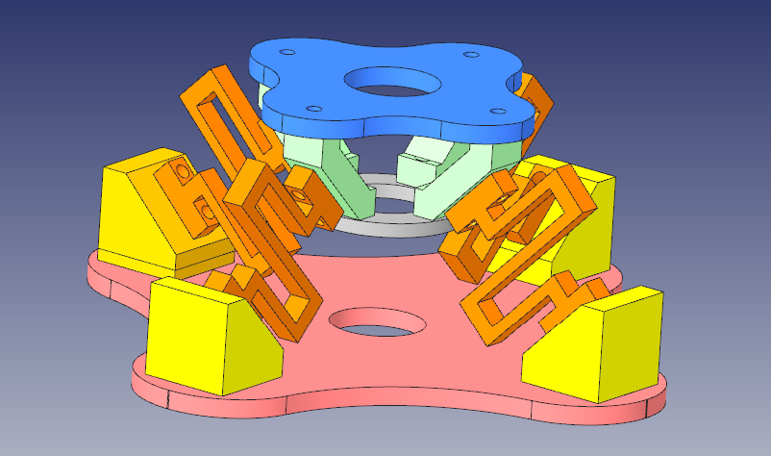
Work Status Update for the Project Magician
Type - II
z
This type of folded beam design is very effective in mitigating the vibrations that are generated in all the 3 directions. But fails to isolate Moments.
The design is bit modest and could also easily incorporated and refined further.
Also the beam stresses could be calculated using the Euler-Bernoulli beam bending equation with some extend kinematics .
y
x

Slide 9
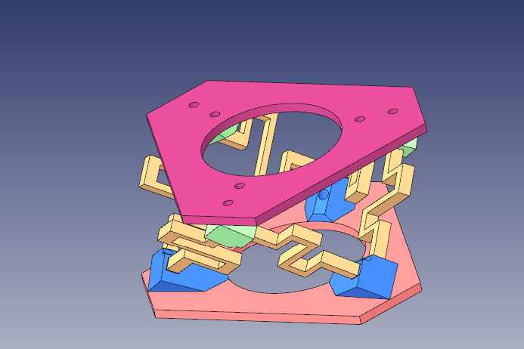
Work Status Update for the Project Magician
Type - III
z
This type of folded beam design is very effective in mitigating the vibrations that are generated in all 6 DOF.
This design is the combination of the Rigid Stewart Gough cubic platform combined with the folded beam structure – A Novel Approach.
Need to calculate the kinematic of this parallel structure and then using Euler-Bernoulli beam bending equation to solve the stress that could generate at very beam with respect to the different loading conditions.
y
x

Slide 10

Work Status Update for the Project Magician
Thank you very much for your Attention

